Slide 1


Data Structures
#LifeKoKaroLift

Slide 2



Module Name- Stacks &
Queues
Class - Day 2
Topic Name: Applications of Stacks and Operations on
Stacks
EditEdit MasterMaster texttext stylesstyles

Slide 3
Time Allocation Summary
Element | Slide numbers | Maximum time(min)
Spot Test | 4
Today’s Agenda | 5
Applications of Stacks | 6 - 18
Operations of Stacks | 19 - 25
Implementation of Stacks | 26 - 27
Matching Parentheses Problem | 28 - 35
Total Time |  | 120

Slide 4
Spot Test
What is data structure? What do you mean by abstract data type?
What is a stack data structure? What property does it follow ? Explain in detail.

Slide 5

Today’s Agenda
Operations of Stack
Implementation of Stack
Applications of Stacks
Parentheses Problem

Slide 6
Applications of Stack
Let’s look at a very common example of stacks in our daily life, the back button on our internet browsers:
Every time you visit a website or the hyperlinks within a website, the contents are pushed onto a stack and the stack keeps on increasing as you visit more and more webpages from your current webpage.
So, when the back button is pressed, we just pop the last webpage pushed into the stack.
The undo feature in text editors and some other softwares uses the same core logic using stacks.

Slide 7
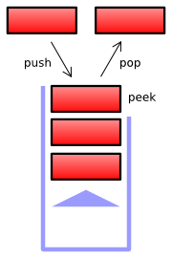
Applications of Stack
Let’s understand it better with another very important application of stacks, Program Stack.
The program stack is also referred to as a call stack, run-time stack, or execution stack.
If you are given a function which makes call to different functions, it is done with the help of a stack data structure.

Slide 8
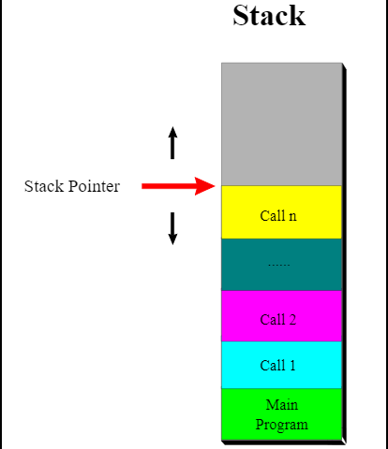
Applications of Stack
Let’s say you have a function – f() which calls a function g() which in turn calls a function h().
Let’s see the working of program stack in this case with the help of a visual demonstration:

Slide 9
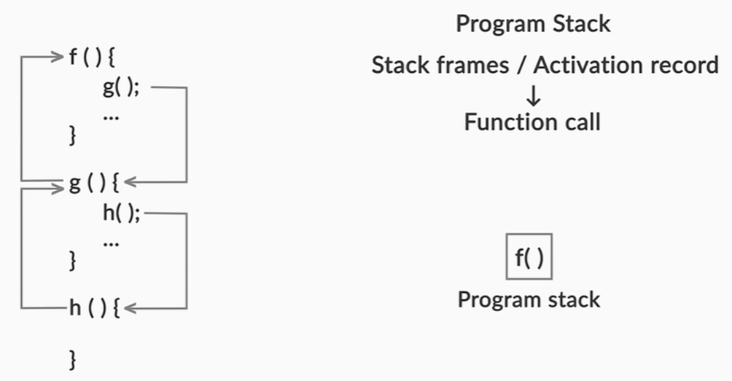
Applications of Stack
So, the program stack first finds a reference to the function f(), pushes it into the stack.

Slide 10
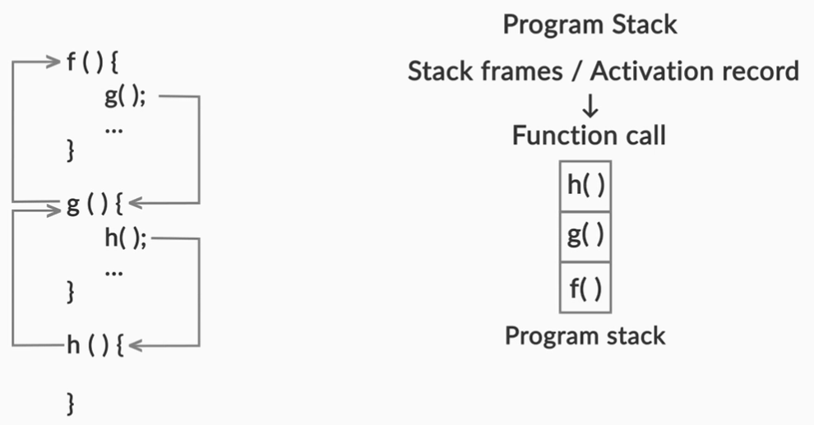
Applications of Stack
Then, it finds the reference to function g(), then pushes it into the stack. Eventually, it finds a reference to function h(), and pushes it into the stack.

Slide 11
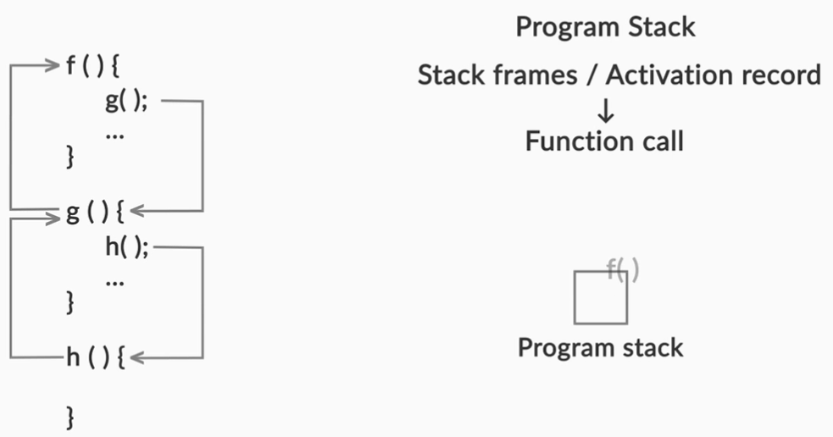
Applications of Stack
When, h() is solved, it is popped from stack. Then g() is solved and popped and finally f() is popped.

Slide 12

Applications of Stack
Now, there is a very common error called ‘stack overflow’, which is caused when you use up more memory for a stack than your program is supposed to use.
For example, when you frame a recursive logic errantly and you give an infinite recursive call, your compiler will give a stack overflow error when the size of the stack grows to be greater than its maximum allowed size.
You all must be familiar with this logo already. Now you know what it literally means as well.

Slide 13

Applications of Stack
This next application of stacks is in the compilers. Compiler is a program which takes your program and turns it into a program in some other language, like machine language or byte code.
A very crucial and complicated function performed by the compilers is parsing which uses stacks during implementation.

Slide 14
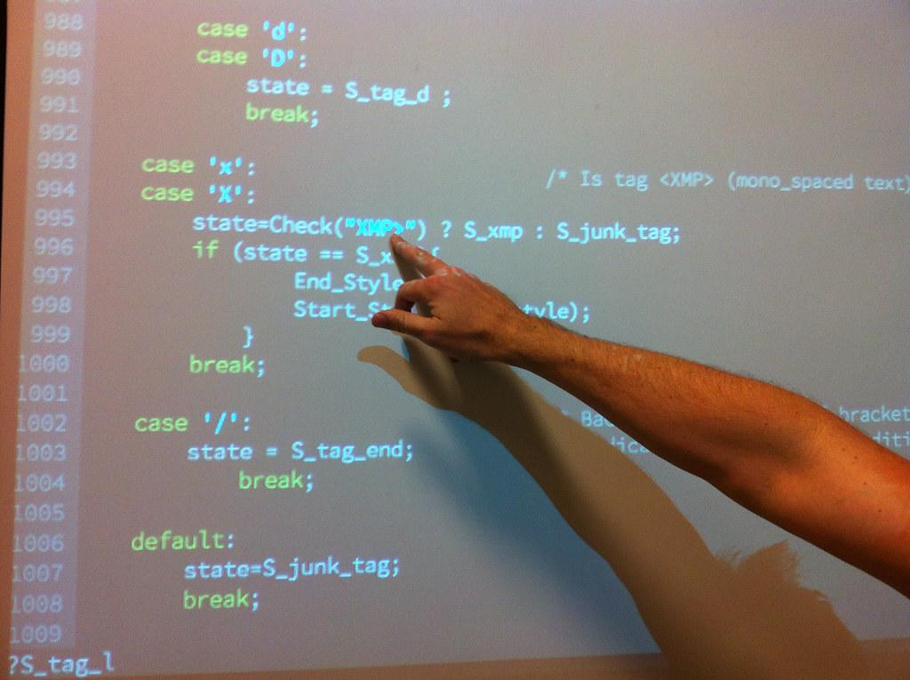
Applications of Stack
Parsing, in simple language, means reading.
A compiler really uses parsing to figure out if a program it’s compiling is really well-formed or not.
All the keywords, punctuation marks etc. are checked.

Slide 15
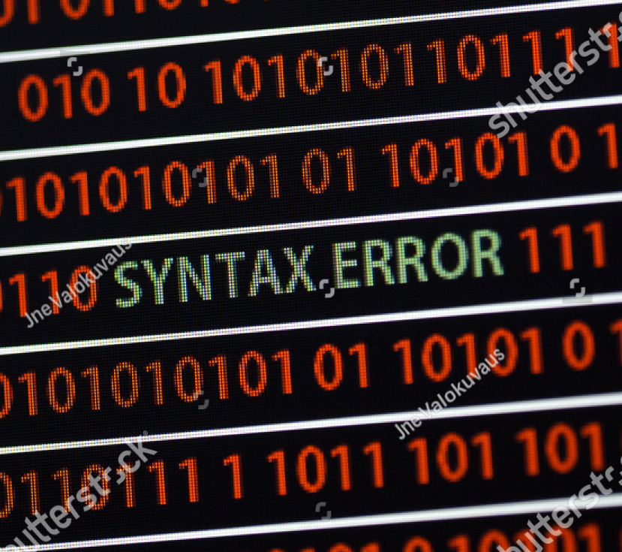
Applications of Stack
For a program to successfully compile, it’s necessary but not sufficient that it should be well-formed.
If a program is not well-formed, i.e. if it’s ill-formed, the compiler will typically detect that, and will flag a syntax error.
An example of syntax error can be taken when the parentheses in a java code aren’t matching. We know that every java function is enclosed in a pair of {,}. Therefore, an unmatched } or { causes a syntax error.

Slide 16
Applications of Stacks
Now, let’s see some examples where we use stacks in real life:
We already saw a very essential application of stack, the program stack.
Now, let’s the example of how an internet browser implements this stack functionality.
Whenever you visit a website, it is added on top of a stack.
When you push the back button, the website at the top of the stack is popped off, and you come at the site which was the previous visited website.
Another important application of stacks is the file versioning system, which is explained in the coming slides.

Slide 17


Applications of Stacks
File versioning is very essential in today’s life because all the important files(including this presentation) have many people working on the same file.
All the major collaborative softwares like google docs, dropbox use stacks as their core data structure and each version of the file is a node in the stack.

Slide 18
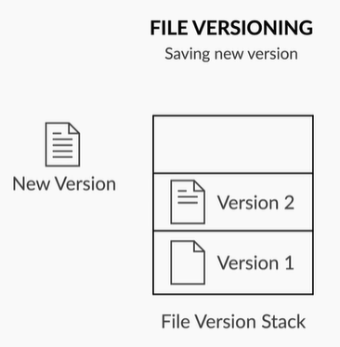
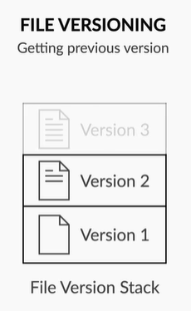
Applications of Stacks
Whenever you make changes to a file let’s say – Version 1, and you save the file, the new file gets stored as Version 2 and is pushed on top of the stack.
Now when you have to undo your changes, you call, pop() which reverts to the previous version.
You could go back multiple versions to restore an older version, or could see the no. of versions etc..

Slide 19
Operations of Stack
Let’s now look at the various operations that can be performed on our newly learnt data structure:
PUSH: Inserts element at the top of the stack
POP: Removes an element from the top of the stack
PEEK: Returns an element from the top of the stack
ISEMPTY: Returns true if the stack is empty otherwise returns false
Let’s understand it better with the help of a visual demonstration:

Slide 20
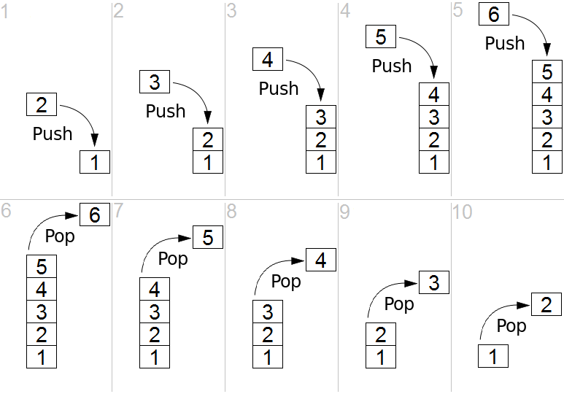
Operations of Stack
pop(6);
pop(5);
pop(4);
pop(3);
pop(2);

Slide 21
Operations of Stack
Let’s see the visualization of the push and pop commands in these two slides:
push(2);
push(3);
push(4);
push(5);
push(6);

Slide 22
Operations of Stack
There is a Stack class in Java which implements stack data structure. The class provides the following functions:
push(object element)- inserts the element onto the top of the stack
pop()- removes an element on top of the stack
isEmpty()- returns true if the stack is empty otherwise returns false
peek()- returns the element on the top of the stack
search(object element)- searches for the element in the stack and returns its location in the stack, If the element is not present then it returns ‘-1’

Slide 23

Operations of Stack
There are two kinds of exceptions you could encounter in stacks:
Underflow: Trying to pop/peek an element from an empty stack
Overflow: Trying to push an element into a stack that is already at its max capacity

Slide 24
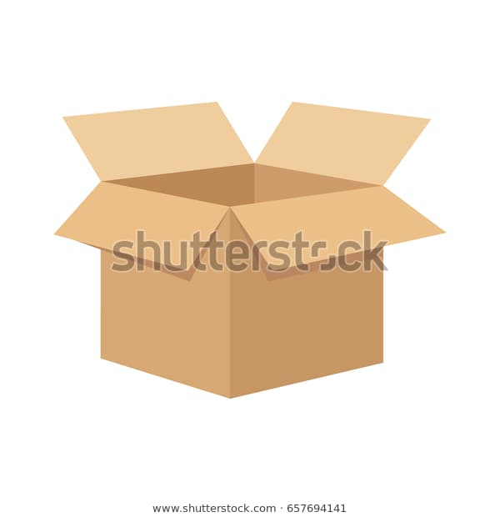
Operations of Stack
You try to avoid these exceptions by writing checks in your code or by handling exceptions.
For the underflow, you saw that a condition was framed, where a pop is not allowed from an empty stack

Slide 25
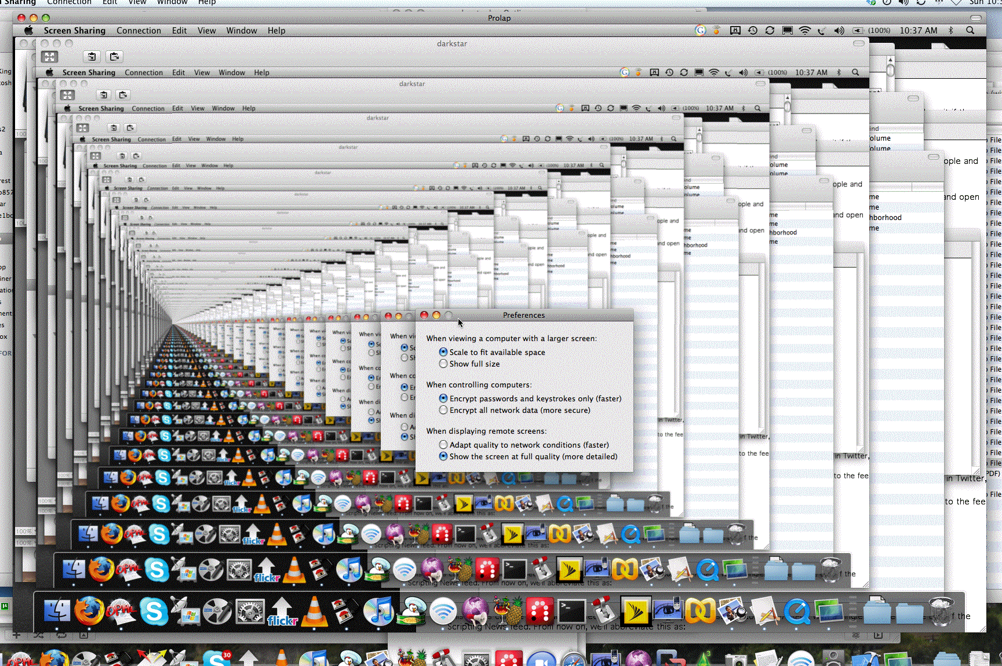
Operations of Stack
On the other hand, you learnt that a stack overflow is caused when you've used up more memory for a stack than your program was supposed to use.
An instance of this is when there are infinite recursive calls and the compiler shows a stack overflow due to the overflow in the program stack.

Slide 26

Implementation of Stack
Here’s an interesting challenge for you. Can you implement a stack using a linked list?
You have to implement our basic methods:
Push
Pop
isEmpty
Can you code a stack now?
(You can use the library LinkedList in java.)

Slide 27
Implementation of Stack
Let’s see the java code of the same:
public void push(T e){
this.list.add(e); }
public T pop(){
if (this.list.size() > 0) {
T e = list.get(list.size() - 1);
list.remove(list.size() - 1);
return e;
}
throw new EmptyStackException(); }
public Boolean isEmpty(){
return this.list.size() == 0; }

Slide 28
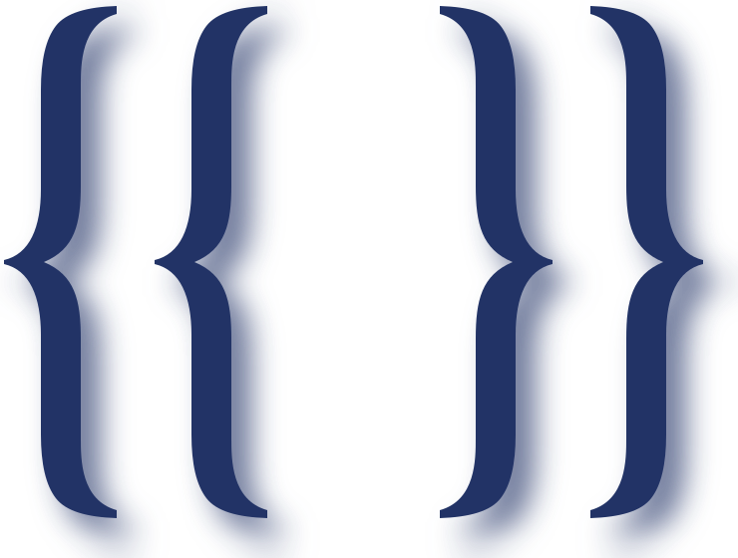
Matching Parentheses Problem
Congratulations, you have completed the basics of stack data structure. Let’s put this knowledge to use now in an attempt to solve a very common and important question, Parentheses Matching.
One of the things that must happen for a program to be well-formed is that all its parentheses should match, i.e. if there’s an open parenthesis anywhere in the program, there must also be a corresponding closing parenthesis.

Slide 29
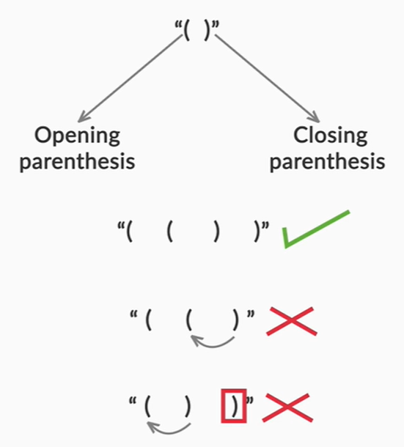
Matching Parentheses Problem
Obviously, the closing parenthesis must follow, and not precede, its corresponding open parenthesis.
For example, "({})" and "(){}()" are well-formed strings, but “(()”, “())” and even ")(" are not.
So, having an equal number of open and close parentheses is necessary but not sufficient for a string to be well-formed

Slide 30
Matching Parentheses Problem
We can use a very basic filter to separate a few of the non-matching parenthesis:
Declare a variable count and initialize it to 0.
Start scanning from the left and one by one, scan each character of the string.
Whenever an opening parenthesis is encountered, increase the count value by one and when a closing parenthesis is detected, decrease it by 1.
If the value is 0, the string is well formed and does not have matching parenthesis. If non zero(either positive or negative), we conclude that the parenthesis are matching.

Slide 31
Matching Parentheses Problem
The code for our algorithm is given below:
int count = 0;
char[] chars = parens.toCharArray();
for (char c : chars) { //loop updating the counter
if (count < 0) {
return false; }
if (c == '(') {
count++; }
else if (c == ')'){
if (count > 0) {
count--; }
else {
return false; }}}
if (count == 0) { //returning final boolean T/F
return true; }
else {
return false; }

Slide 32
Matching Parentheses Problem
The approach we just saw is very efficient when we have to deal with a single type of bracket (either ‘(’ or ‘{’).
But as we saw in examples earlier, there may be string with both types of brackets, for eg. “({}){}”.
Will a single counter accommodate all the types of brackets?
If not, what changes should be done to make out algorithm work?

Slide 33
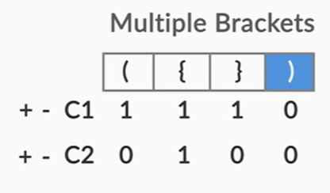
Matching Parentheses Problem
The answer is NO. We will have to use multiple counters each of which keeps the track of count of a particular type of bracket.
The output will be true only if all the counters have 0 value after string traversal.
The image on right explains one such example. Since both the counters C1( for ‘()’) and C2( for ‘{}’) have zero as the count values after all the characters are traversed, the parentheses are said to be matching.

Slide 34
Matching Parentheses Problem
Let’s check the code for our new algorithm:
int count1 = 0, count2 = 0;
char[] chars = parens.toCharArray();
for (char c : chars) { //loop updating the counters
if (c == '(') {
count1++;
} else if (c == ')') {
if (count1 > 0) {
count1--;
} else if (c == '{') {
count2++;
} else if (c == '}') {
if (count2 > 0) {
count2--;
} else {
return false; }
} else {
throw new Exception("Invalid character " + c);}}}

Slide 35
Matching Parentheses Problem
if (count1 == 0 && count2 == 0) { //returning final boolean T/F
return true;
} else {
return false; }}
As we saw, the code with two counters became a little entangled with the conditional statements.
Moreover, this algorithm doesn’t work all the times. What about a string like “({)}”? It is clear that brackets aren’t matching. But what does our logic say?
we can use stacks to solve this problem for both single and multiple bracket types.

Slide 36
Thank You!
#LifeKoKaroLift

